Slide 1
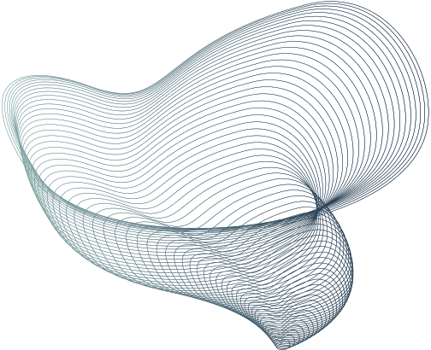

HARAM SAFE
Reliable Crowd Management for Masjid al-Haram

Slide 2
Why crowd reliability at the Haram matters
Each year Haram hosts millions of pilgrims from around the word during Hajj/Ramadan
Any small delays in response , human error , can escalate to a catastrophic failure, System Failure , that can cost human lives
To design a reliable systems means that the system would still work under sensor loss , link failure , or operator overload.
Our approach to the system is applying : Fault avoidance , Fault detection , and Fault detection
current scale :
Hajj 1445H (2024): 1,833,164 pilgrims
Hajj 1446H (2025): 1,673,230 pilgrims

Slide 3
Natural Hazards
Tech Hazards
Heat surges
Dangerous density
Evacuation impediments
Hazards & Reliability Targets
Digital outages
Alert fatigue
some
Crowd Threshold
Reliability Goals
Green ≤ 4 people/m²
Red ≥ 6 people/m²
Availability ≥ 99.99% (peak hours);
POFOD ≤ 1×10⁻⁵ per safety demand;
ROCOF false-red ≤ 1 per 12 h

Slide 4
System Architecture
Data collection : CCTV computer vision, overhead thermal counters, BLE/Wi-Fi , manual clickers.
Data transport : 5G + fiber , QOS
Self-monitoring analytics :
Channel A : CV model 1 (vendor + backbone)
Channel B: CV model 2 (another vendor + backbone)
comparing : flags mismatch > over N frames > conservative fallback
Protection service : watches density/derivative/heat; commands issues Close/Reroute/One-Way directly to field controllers
Operators UI : Bilingual console + playbook, manual override
Actuators : screen dynamic signage, barriers, gates, misting, water dispatch

Slide 5
Reliability patterns
Protection System (simple, diverse, independent): enforces thresholds and executes actions with very low POFOD.
Self-Monitoring (multi-channel): two heterogeneous models + comparator; on mismatch → safe-side fallback.
Active-Active High Availability: two monitoring stacks; failover without operator action.
Time-bounded calls (timeouts) to all external services; bounded queues; idempotent commands to actuators.
Data diversity: thermal + vision + presence reduce single-modality bias.

Slide 6
Top event: crowd crush in zone Z
Trigger: density ≥ 6 p/m² for ≥ 30 s
Late response: action > 90 s after first red
Why density rises: inflow spike · bottleneck · counter-flow · obstacle
Why action is late: sensor/analytics down · operator overload · command path fail · physical jam
What we do: one-way routing + obstacle control; independent protection sends Close/Reroute with timeout+ retry
Fault tree + coding guidelines
Encapsulate config (no globals)
Validate every input (range/format)
Handle all exceptions
Avoid shared mutables / FP equality
Safe restart & resume (recover state)
Bounds checks on arrays/queues
Timeouts on I/O/actuation (≈2 s try)
Named constants (no magic numbers)

Slide 7

Testing like the real world
Operational profiles (weights): Evening Umrah (0.35), Friday prayers (0.15), Ramadan(0.20), Hajj peak windows (0.20), Off-peak (0.10).
Scenario drills: sudden gate closure, enforce one-way flows, create ambulance corridor (< 90 s).
Chaos tests (off hours): drop camera feed, fail one 5G link, crash one model—protection must still act.
Human-in-the-loop: bilingual UI usability and alert fatigue checks.

Slide 8
How we measure and prove reliability
Availability (AVAIL) per peak hour, POFOD for safety actions, ROCOF for false-reds, p95 detection latency.
Prototype simulation (discrete time): arrivals → Mataf density → thresholds → measure AVAIL & POFOD with injected failures.
Observed (illustrative run): Availability ~96.9%, POFOD ~4.0% → needs higher MTBF, lower MTTR, and parallel stacks to reach targets.
Path to targets: 2 active-active stacks (independent) + auto-failover + faster repair → hour-level AVAIL ≥ 99.99%; tiny protection service to push POFOD ≤ 1e-5.

Slide 9

Vision 2030 & Future
Artificial Intelligence (AI)
Dual CV channels + comparator
Predictive reroute suggestions
Ethics
Scalability
PDPL by design: counts/heatmaps only
Edge blurring, short retention, audit trails
Digital twin; 5G slicing + fiber ring
Metro/train integration; active-active DC

Slide 10
THANK YOU

